Slide 1
WELCOME
TO :Poultry Farm Management System
By. Gurav Shraddha Ramesh.
More Sanskruti Krushnat.

Slide 2
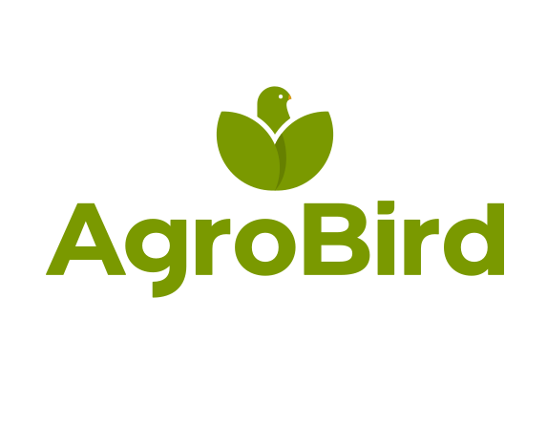
Welcome To Poultry Farm Mangement System

Slide 3
Introduction :
Project Goal : The Poultry Farm Managememt Application is designed to streamline farm operations, enhance productivity, and improve profitability through automation and real-time monitoring. Key Features : User and Staff login, Maintain Application security, Daily Lot Status Report, Feed Rreport,etc.
Technical Requirements : Programming languages: C#, Database management: MySQL.
Project Outcome : A fully functional To Save Day Todays Lot Status,And It Is Easy To Use For Farmer.

Slide 4
Requirement Analysis :
Software Requirements :
Programming Language - C#
Operating System - Windows 10/11
Platform - .Net Framework 4.5
IDE - Visual Studio 2019/2022
Database - MySQL Server 2019
Reporting - RDLC or Crystal Report

Slide 5
Requirement Analysis :
Hardware Requirements :
Processor - Intel Core i3 (8th Gen or higher)/AMD Ryzen 5
RAM - Minimum 4 GB (16 GB for smoother multitasking)
Device - Keyboard and Mouse
Hard Disk - Minimum 100 GB HDD
Display - Minimum 1920x1080 resolution for better visibility

Slide 6
Objectives:
1. Efficient Farm Management
Provide a centralized platform to monitor and manage poultry farm activities.
Automate daily farm operations, including feeding, health tracking, and production management.
2. Health and Disease Management
Track poultry health, mortality rates, and symptoms in real time.
Provide automated vaccination schedules and reminders.
3. Environmental Control and Optimization
Monitor and regulate temperature, humidity, and air quality using IoT sensors.
Provide automated alerts for extreme environmental conditions affecting poultry health.
4. Feed and Nutrition Management
Optimize feed consumption with AI-driven recommendations.
Track feed stock levels and automate reordering to prevent shortages.

Slide 7
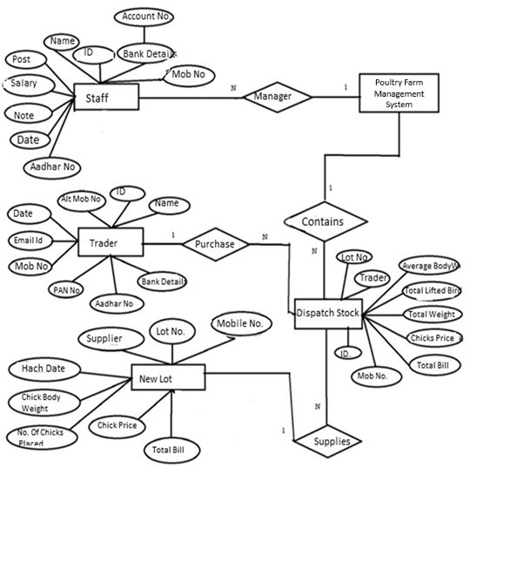
Entity Relationship Diagram:

Slide 8
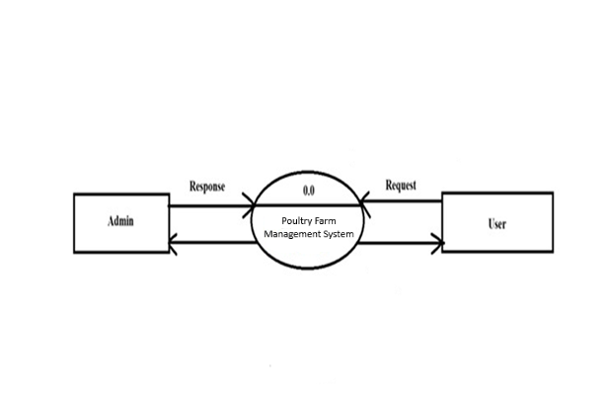
Data Flow Diagram:
Level Zero Diagram:

Slide 9
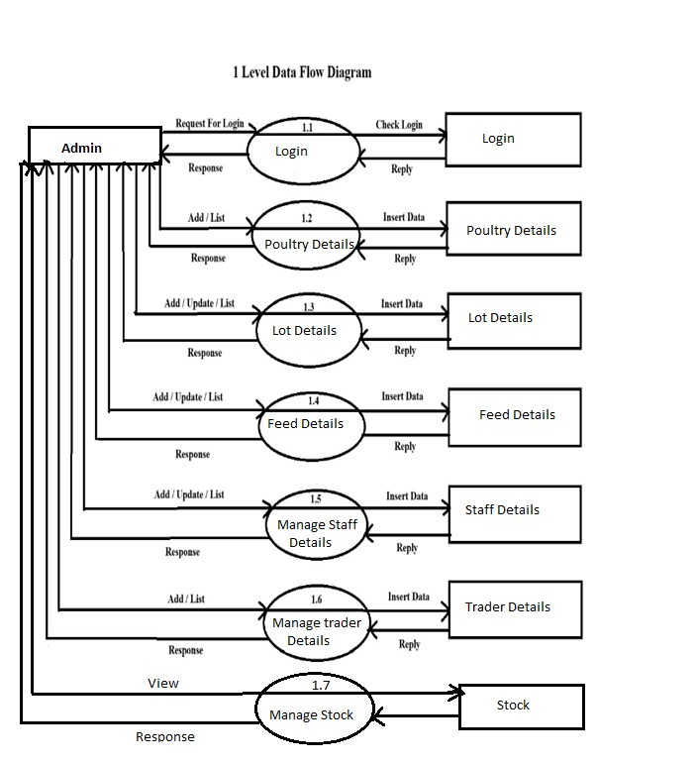
Data Flow Diagram:
Level First Diagram :

Slide 10
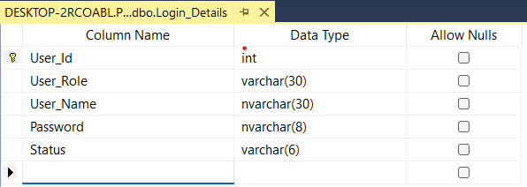
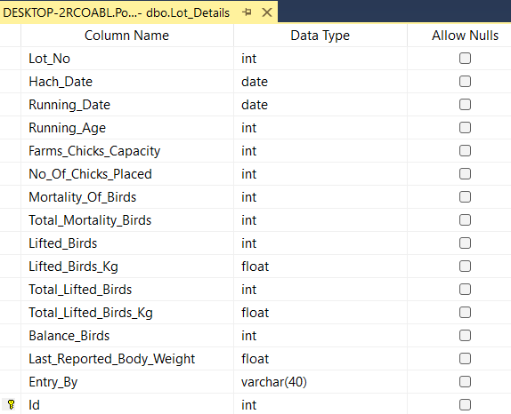
Snipping of Main Forms
Table Name:- Login
Description:-It Store Login Information
Table Name:- Lot Details
Description:- It Store Lot Daily Information

Slide 11
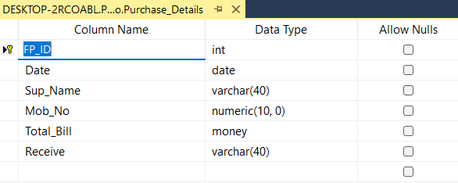
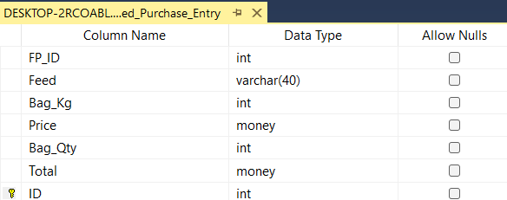
Table Name:-Feed Purchase Details
Description:-It Stores Purchase Details
Table Name:-Feed Purchase Entry
Description:-This Table Stores Information Of Feed Purchase.

Slide 12
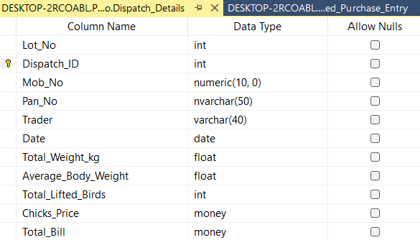
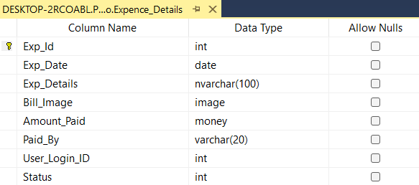
Table Name:- Dispatch Details
Description:- This Is Used To Dispatch Stock.
Table Name:- Expence Details
Description:- It store Expence Details Of Poultry .

Slide 13
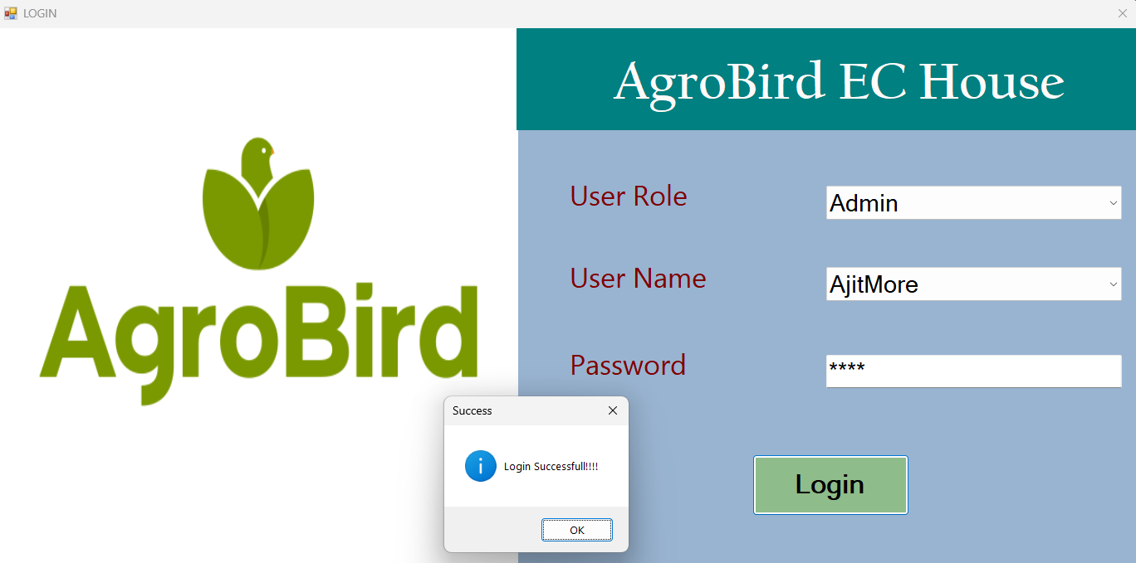
Reports generated : Login:

Slide 14
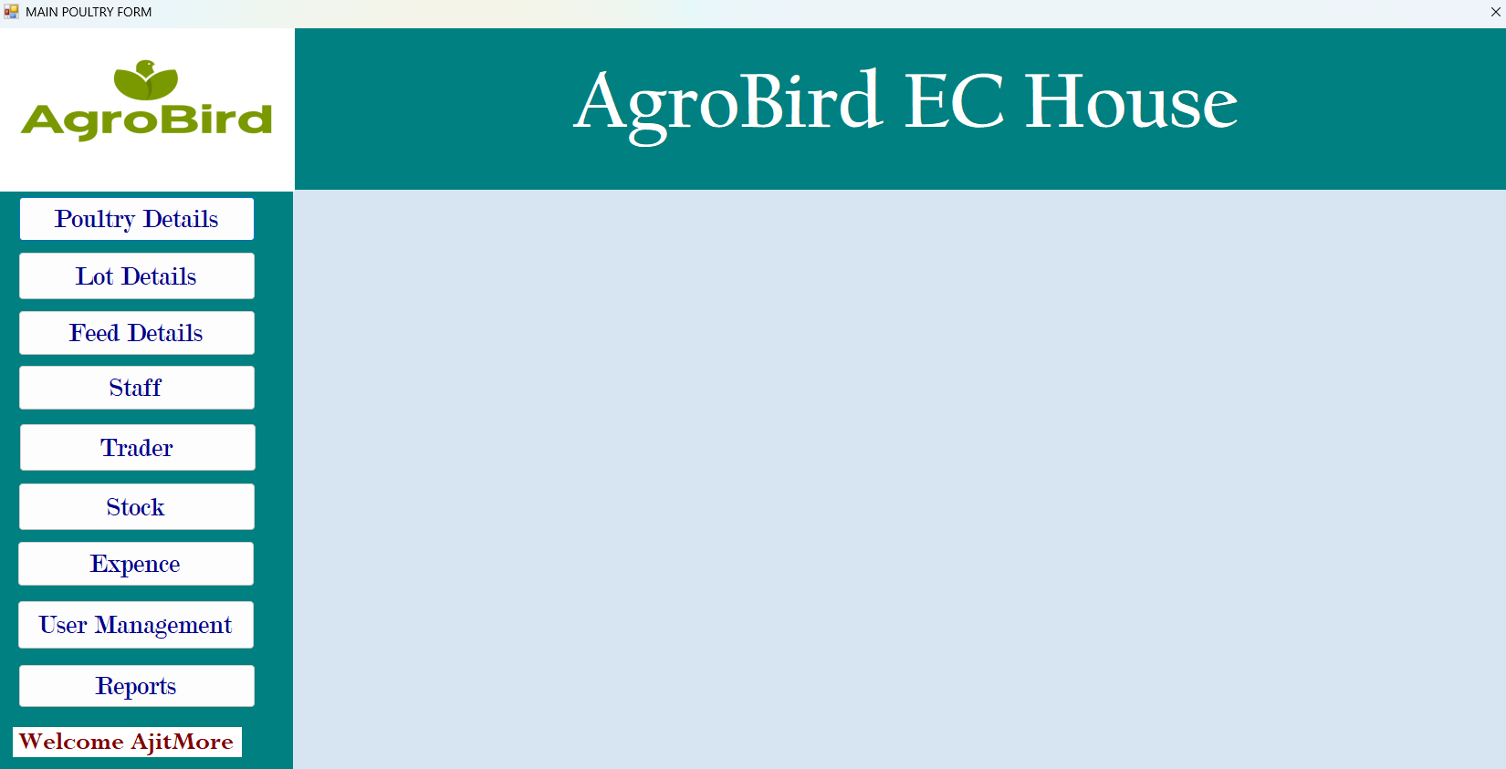
Admin Login:

Slide 15
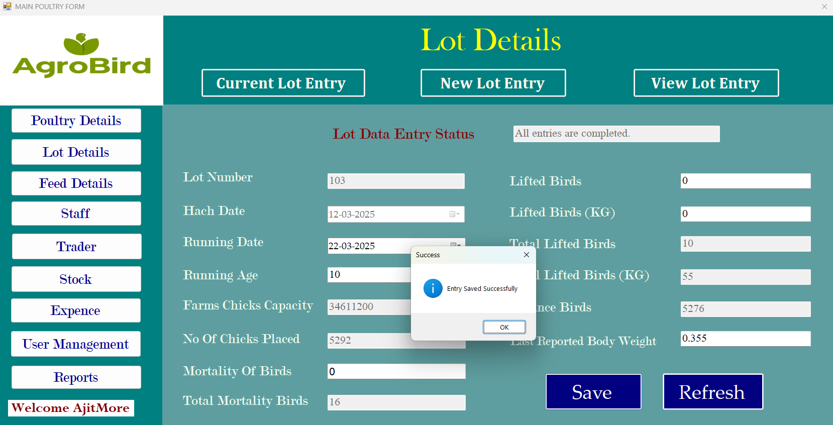
Lot Status:

Slide 16
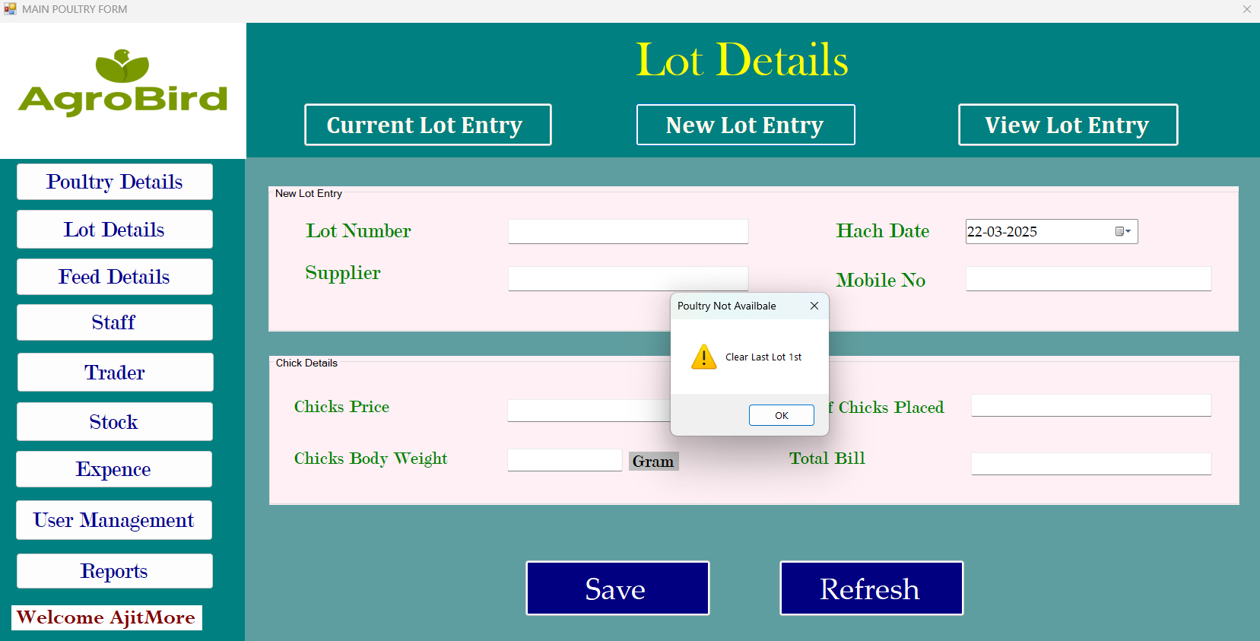
New Lot Entry:

Slide 17
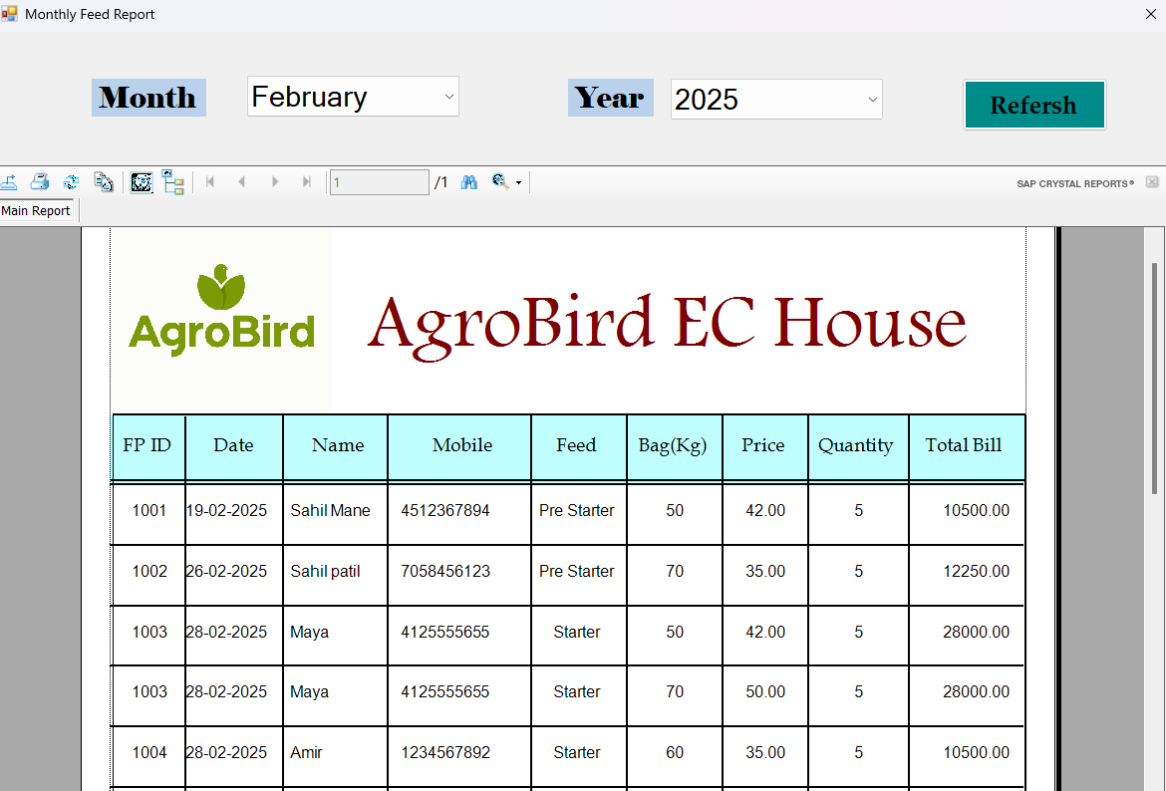
OUTPUTS : Monthly Feed Purchase Report:-

Slide 18
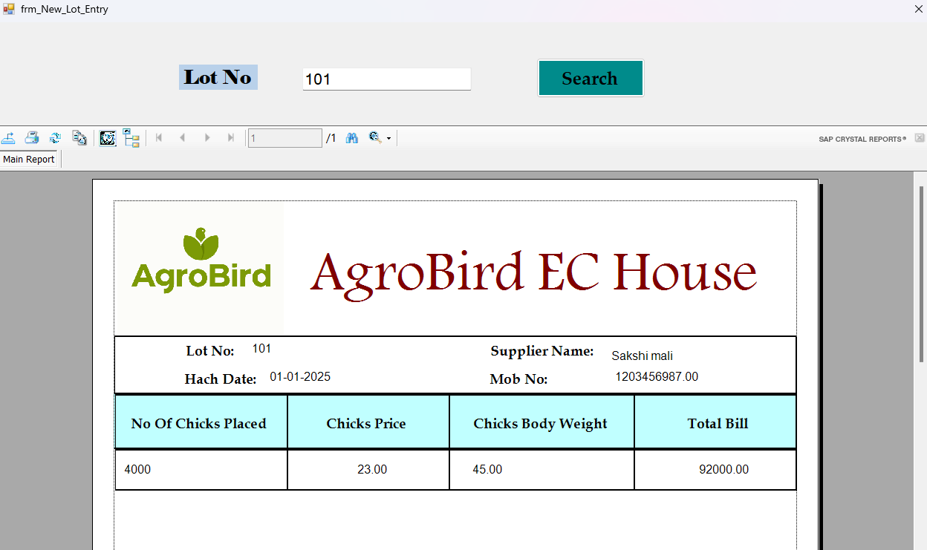
New Lot Report:

Slide 19
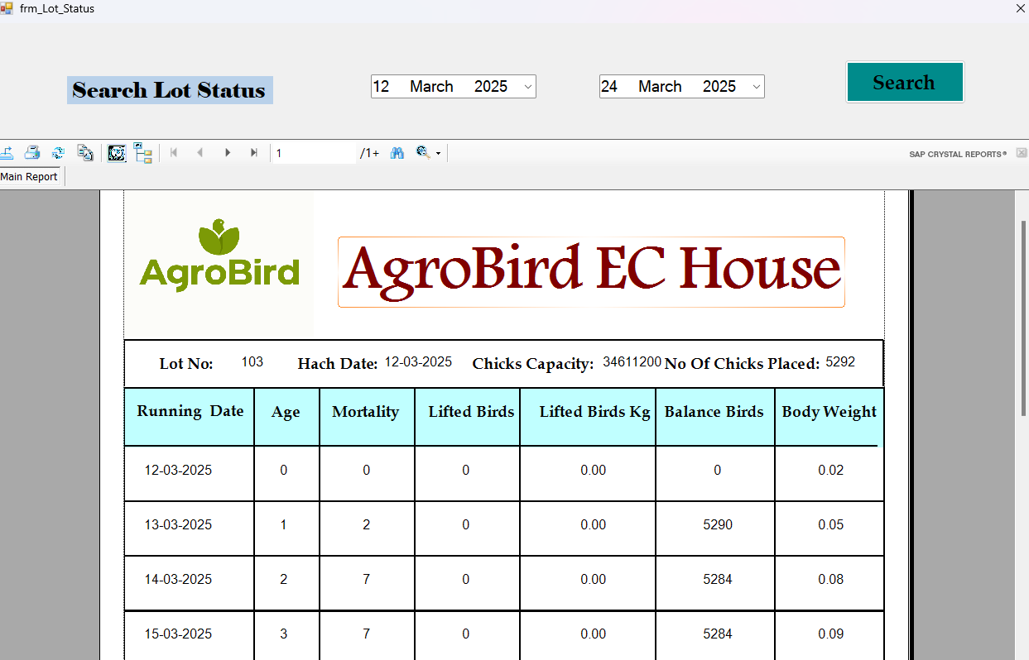
Lot Current Status :

Slide 20
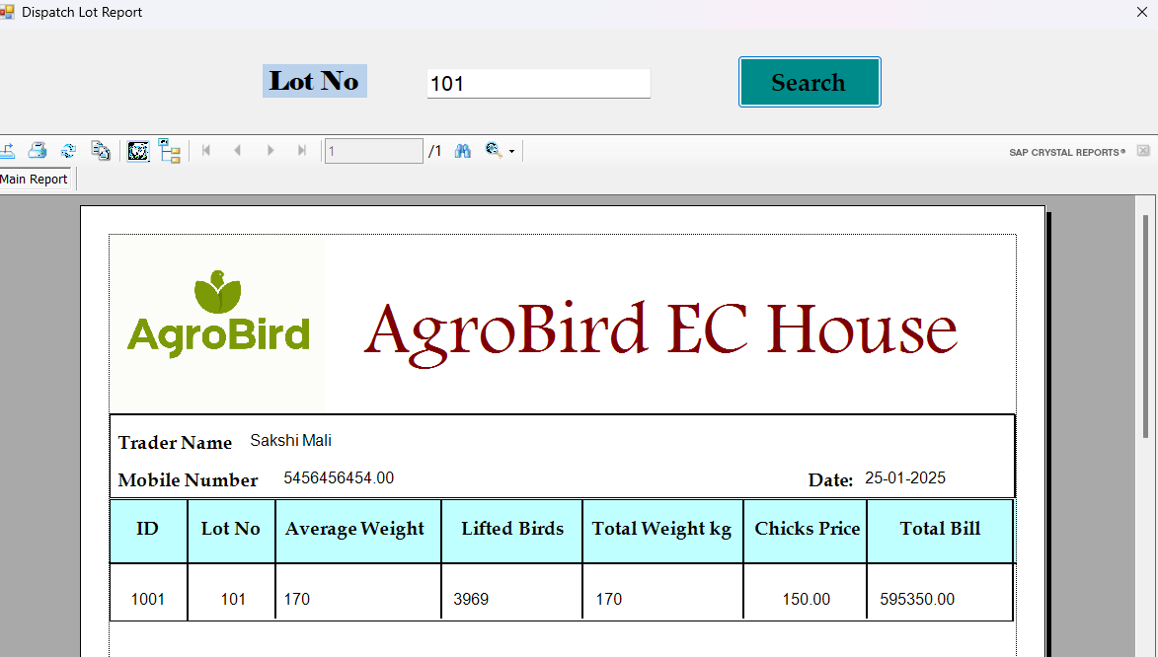
Lot Dispatch:

Slide 21
Future enhancement:
Future Enhancements
To further improve the poultry farm management System, the following future enhancements can be considered:
AI-Powered Analytics:
Implement artificial intelligence (AI) to analyze farm data and provide predictive insights on poultry growth, egg production, and feed consumption.
Automated Feed Management:
Integrate automated systems that regulate the feed supply based on real-time consumption data, ensuring the optimal feeding schedule.
Mobile Access & Notifications:
Develop a mobile app version of the application that sends real-time notifications to farm managers about critical events (e.g., low feed levels, temperature fluctuations, health issues).
Disease Prediction and Monitoring:
Implement health monitoring features with real-time data collection and disease prediction algorithms, helping early detection and reducing outbreaks.

Slide 22
Conclusion:
The integration of a poultry farm manager app in modern poultry farming has revolutionized the industry by providing a comprehensive, data-driven approach to farm management. By leveraging digital technology, poultry farmers can streamline operations, enhance efficiency, and optimize productivity. The app serves as a centralized platform for monitoring crucial farm activities such as feed management, disease control, financial record-keeping, and environmental monitoring.
One of the most significant advantages of a poultry farm manager app is its ability to automate and simplify various farm processes. Traditional poultry farming methods often rely on manual record-keeping and observation, which are prone to human errors and inefficiencies.
Moreover, a poultry farm manager app enhances financial management by enabling farmers to track expenses, calculate profits, and manage inventory efficiently. Detailed financial records help in cost analysis, ensuring that farm resources are utilized effectively.

